Slide 1
TM354 Software Engineering Introduction
Chris Thomson c.d.thomson@open.ac.uk

Slide 2
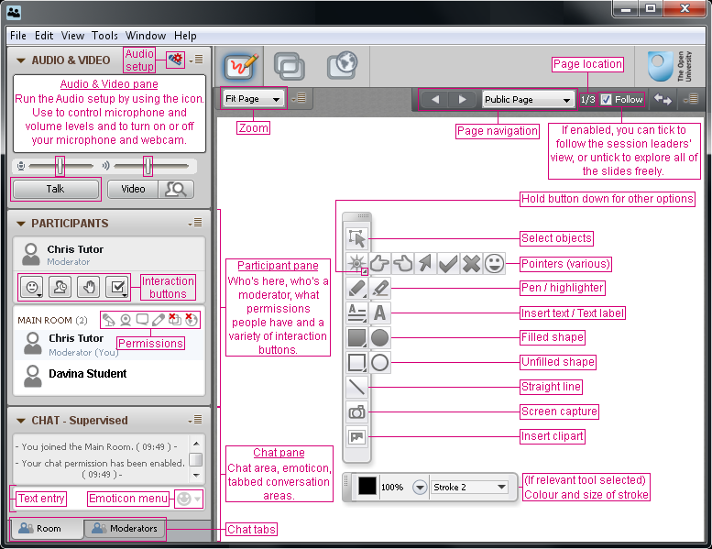
Using OU Live

Slide 3
Introduction
What is Software Engineering?
Why should you care about it?
What is used in practice and how is TM354 different?

Slide 4
Module outline
From domain to requirements (Block 1)
From analysis to design (Block 2)
From architecture to product (Block 3)
4 units/block
Each block has a printed book
Case study as the last unit of each block
All other resources on website
Including further topics

Slide 5
Assessment
TMAs
Key tips
Level of detail
Checking your work
Exam
What to expect

Slide 6
Getting help
Please ask, and ask again if things don’t make sense.
Often a short discussion on the phone clears up email confusion.
If I’m speaking gibberish, tell me!

Slide 7
Block 1

Slide 8
Block 1, Unit 1
Approaches to software development
software and development processes
different approaches to software development
from plan-driven to agile
factors that affect the choice of a process.
modelling within software development
agile perspective

Slide 9
Block 1, Unit 2
Requirements concepts
requirements
Functional
non-functional
testing and fit criteria
what and how much to document

Slide 10
Block 1, Unit 3
From domain modelling to requirements
understanding the domain
business rules and processes
representing domain activity
capturing requirements with use cases
prototyping the user interface

